Slide 1

Chapter 8
Binary Search Trees

Slide 2
Searching
It is often necessary to access an element in a structure that matches a specific condition
Not just direct access (e.g., array[4])
For example, find student in list with ID number 203
Each structure must define its own methods for searching for elements

Slide 3
Search Specification
FindItem (item, location) (a member function)
Function: Determine if an element of the list has a key that matches item’s
Precondition: The list has been initialized, item’s key has been initialized
Postcondition: Location = the position of the matching element, or NULL if no such element exists
“Position” could mean an array index or a pointer into a linked list

Slide 4
Linear Search
Simple algorithm: Walk the list, checking each item to see if it matches
Must be used if the list isn’t sorted by key
O(N) search, performs on average N/2 comparisons assuming an equal probability of searching for any element

Slide 5
High Probability Ordering
Sometimes, a few list elements are in greater demand than others
It would be very useful to optimize the ordering of elements to make search more efficient in this case
Search would still be O(N) in the worst case, but the average case approaches O(1)
This is called a self-adjusting list

Slide 6
High Probability Ordering (cont.)
How should elements be reordered?
Naive approach: Every time an element is searched for, move it to the front of the list
Inefficient for arrays; don’t need to move an element to the front if it’s only searched for once
Better approach: Every time an element is searched for, swap it with its predecessor
In-demand elements bubble to the front

Slide 7
Key Ordering
Sorted lists allow the use of more efficient search algorithms
Linear search can stop as soon as it passes the position were the element should have been
Inserting all elements in sorted order is O(N²), but inserting then sorting is O(N log₂N)
With sorted lists, binary search may be used

Slide 8
Binary Search
Discussed previously in Chapters 4 and 7
Uses divide-and-conquer approach to perform O(log₂N) search
Requires an array-based list that is already sorted
Could binary search be used by linked lists?

Slide 9
Trees
Linked lists are linear structures: each node has a unique successor (except for the last node)
Binary Trees: A structure with a unique starting node (the root), in which every node has at most two children and there is a unique path from the root to every node
Nodes without children are called leaf nodes

Slide 10
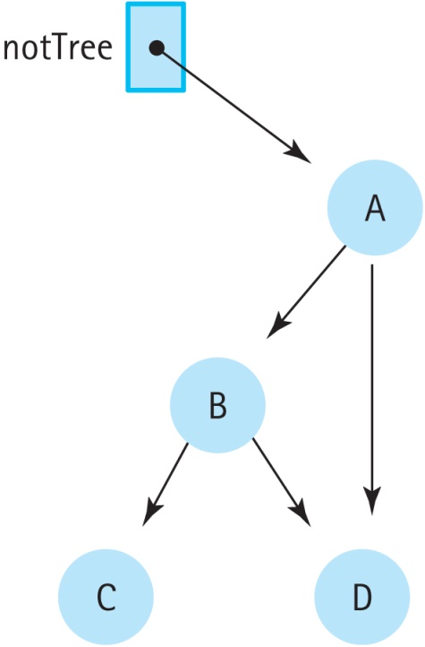
Unique Paths
This structure is not a tree:
There are two paths from the root (A) to the node D. Each node must have at most one parent.

Slide 11
A Recursive Structure
The left and right children of a node are the roots of the left and right subtrees of that node
That is, a binary tree can be recursively split into smaller binary trees
This is a useful property that makes writing recursive routines on binary trees easy

Slide 12
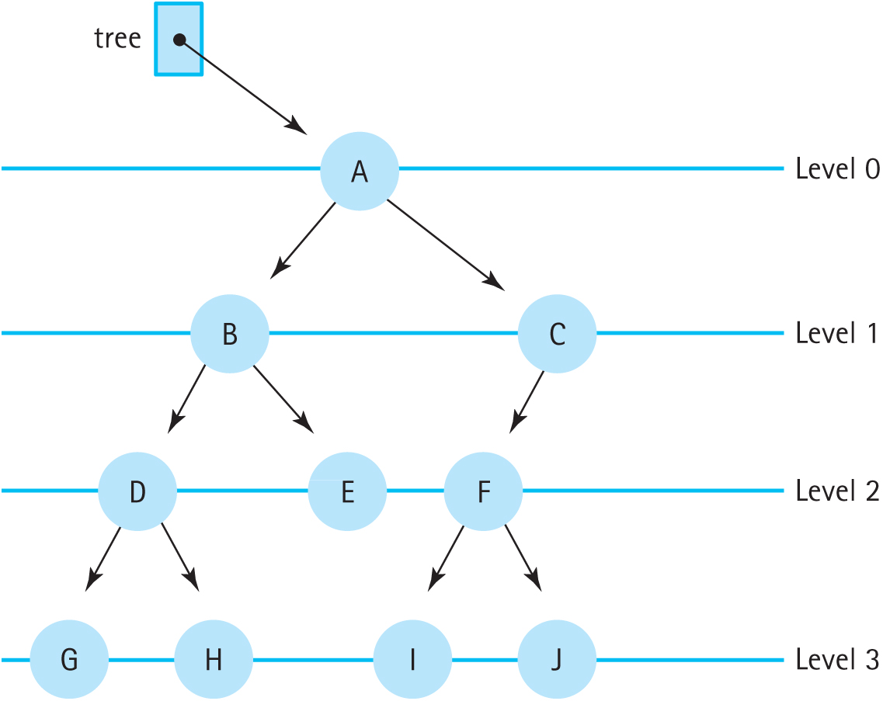
Binary Tree
Figure 8.1 A binary tree

Slide 13
Level and Height
Level: The distance of a node to the root
The number of nodes at level N is at most 2^{N}
Height: The maximum level of the tree
With N nodes, the max height is N and the minimum height is log₂N + 1
Height determines efficiency; a minimum height tree supports O(log₂N) access of every element, but a max height tree is O(N)

Slide 14
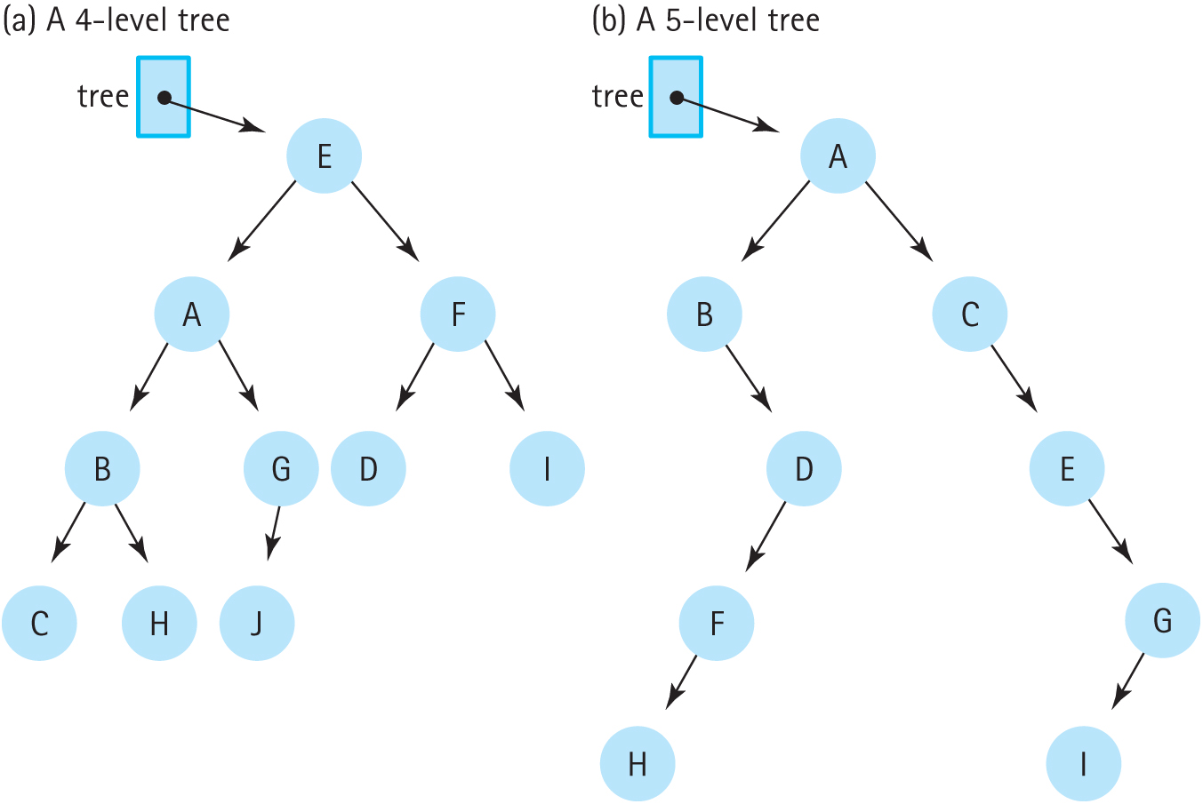
Level and Height (cont.)
Figure 8.2 Binary trees with ten nodes (a) A 4-level tree (b) A 5-level tree

Slide 15
Binary Search Trees
If elements are unordered, searching binary trees is still O(N)
Binary Search Property: The left subtree of a node contains only values less than the node, and the right subtree contains only values greater than the node
A tree with this property is called a Binary Search Tree (BST)

Slide 16
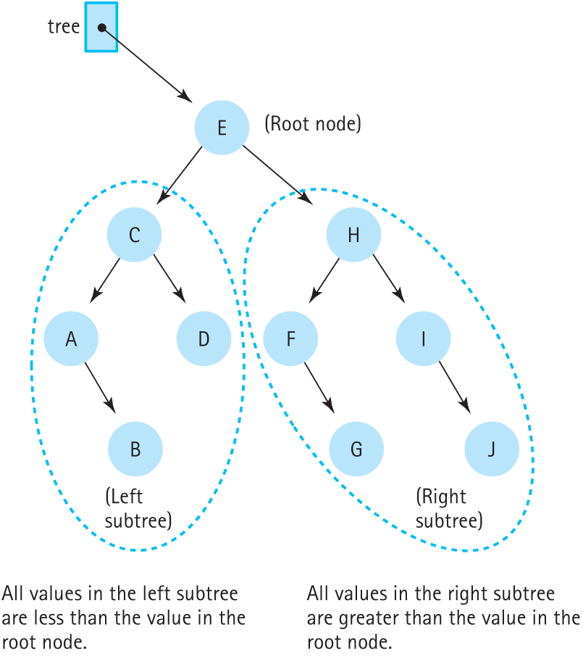
Binary Search Tree
Figure 8.3 A binary search tree

Slide 17
BST: Logical Level
Inserting and deleting (PutItem, DeleteItem)
Observers: IsEmpty, IsFull, GetLength, GetItem
Iterators: ResetTree and GetNextItem
Unlike lists, there is more than one way to iterate through a tree
These are called tree traversals
Utility: MakeEmpty and Print

Slide 18
BST: Application Level
Generally, binary search trees can be used in place of lists
Like lists, they can be used to implement other data structures
Binary search trees provide O(logN) insertion, O(logN) deletion, and O(logN) search (assuming the tree is close to min. height)

Slide 19
BST: Implementation Level
BSTs are linked structures with dynamically allocated nodes
Each node has a pointer to each child
Since BSTs are inherently recursive (each node is the root of a tree), the algorithms will be implemented recursively

Slide 20
Recursive BST Operations
The TreeType class contains a pointer to the root of the tree itself
The recursive operations will operate on nodes
Therefore, the member functions call recursive helper functions that take the root of the tree as parameters

Slide 21
IsFull and IsEmpty
IsFull: BSTs are logically unbounded; IsFull attempts to allocate memory and returns “true” if a bad_alloc exception is thrown
IsEmpty checks if the root of the tree is NULL
These observers are identical to the linked list methods

Slide 22
GetLength
Number of nodes in tree = Number of nodes in left subtree + Number of nodes in right subtree + 1
What are the base cases?
Left child is NULL
Right child is NULL
Both children are NULL
Do we need a branch for each case?

Slide 23
GetLength (cont.)
Simplify: If the tree is NULL, return 0
Otherwise, return the count of the two child trees + 1
This elegantly handles the base cases; if the children are NULL, the function will return 0

Slide 24
GetLength and CountNodes
int CountNodes(TreeNode* tree);
int TreeType::GetLength() const
// Calls the recursive function CountNodes to count the
// nodes in the tree.
{
return CountNodes(root);
}
int CountNodes(TreeNode* tree)
// Post: Returns the number of nodes in the tree.
{
if (tree == NULL)
return 0;
else
return CountNodes(tree->left) +
CountNodes(tree->right) + 1;
}

Slide 25
GetItem
Because GetItem searches the tree, it can be programmed recursively
As before, GetItem takes references to the item to search for and a Boolean flag and updates these parameters as necessary
If the item is found, the item reference is updated and the flag is set to true
If not, the flag is set to false

Slide 26
GetItem Specification
Definition: Searches for an element with the matching key; if it is found, return the item
Size: Number of nodes in the tree or number of nodes in the path from the root
Base Cases: If the item is found, the pointers are set; if not, only the flag is set to false
General Cases: Search the appropriate subtree if the key is less than or greater than the node

Slide 27
GetItem and Retrieve
ItemType TreeType::GetItem(ItemType item, bool& found) const
{
Retrieve(root, item, found);
return item;
}
void Retrieve(TreeNode* tree, ItemType& item, bool& found)
{
if (tree == NULL)
found = false; // item is not found.
else if (item < tree→info)
Retrieve(tree->left, item, found); // Search left subtree.
else if (item > tree→info)
Retrieve(tree->right, item, found); // Search right subtree.
else
{
item = tree->info; // item is found.
found = true;
}
}

Slide 28
PutItem
Conceptually similar to inserting into a sorted linked list
PutItem must maintain the binary search property
PutItem calls the recursive Insert helper method
Insert takes a reference to a pointer so that it can update the pointer and the node

Slide 29
Insert
Definition: Inserts an item into the tree
Size: The number of elements in the path from the root to the point of insertion
Base Case: If the tree is NULL, allocate a new node
General Case: Insert into the left or right subtree as appropriate

Slide 30
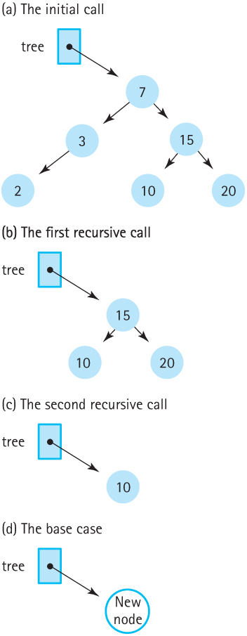
Insert(13)
Figure 8.8 The recursive Insert operation (a) The initial call (b) The first recursive call
(c) The second recursive call (d) The base case

Slide 31
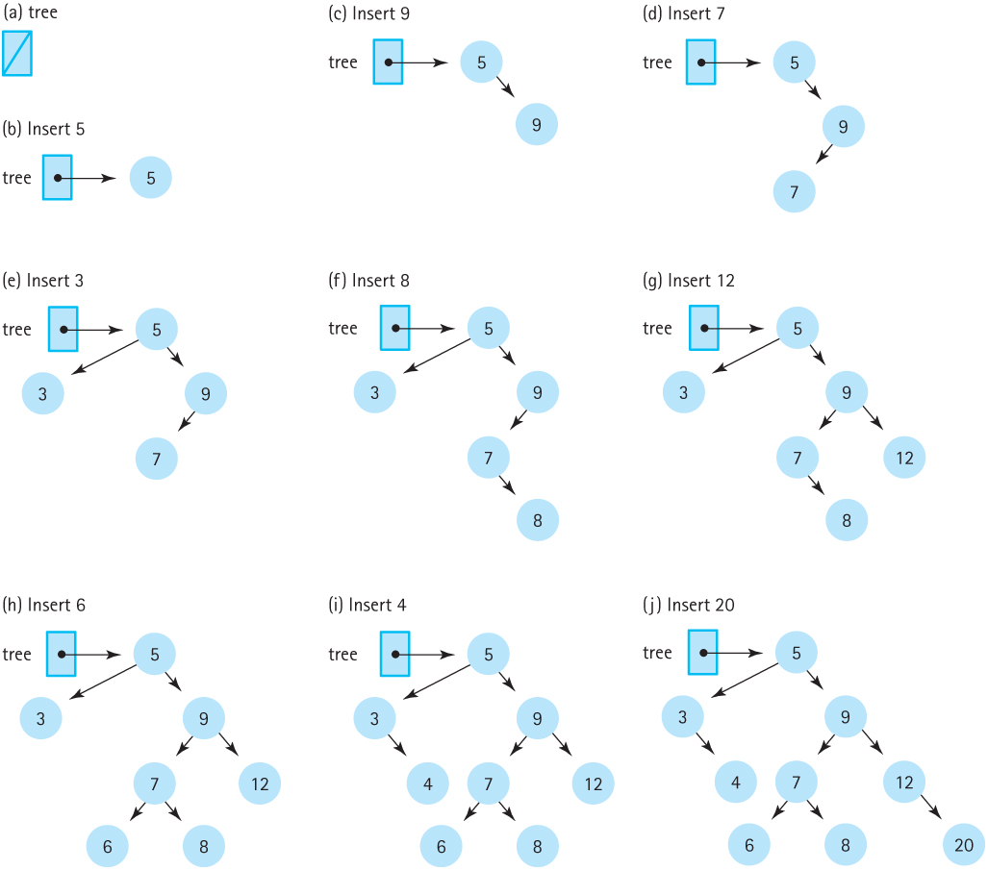
Building Up a BST
Figure 8.7 Insertions into a binary search tree (a) (b) Insert 5 (c) Insert 9 (d) Insert 7
(e) Insert 3 (f) Insert 8 (g) Insert 12 (h) Insert 6 (i) Insert 4 (j) Insert 20

Slide 32
PutItem and Insert
void Insert(TreeNode*& tree, ItemType item);
void TreeType::PutItem(ItemType item)
{
Insert(root, item);
}
void Insert(TreeNode*& tree, ItemType item)
{
if (tree == NULL)
{// Insertion place found.
tree = new TreeNode;
tree->right = NULL;
tree->left = NULL;
tree->info = item;
}
else if (item < tree->info)
Insert(tree->left, item); // Insert in left subtree.
else
Insert(tree->right, item); // Insert in right subtree.
}

Slide 33
Insertion Order and Tree Shape
The order nodes are inserted determines the shape of the resulting tree
Inserting nodes in order will result in a long, list-shaped tree
Inserting nodes in random order results in a “bushy” and therefore more efficient tree
It is possible to rearrange a tree after insertion

Slide 34
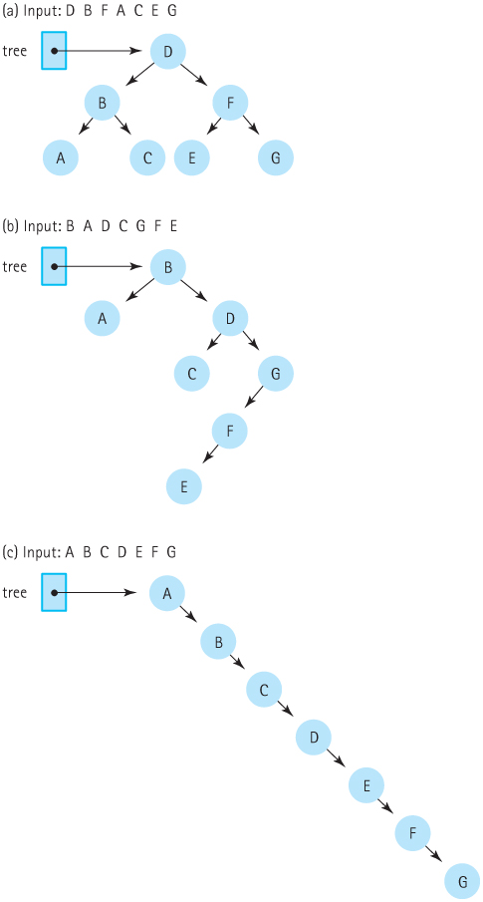
Insertion Order and Tree Shape (cont.)
Figure 8.10 The input order determines the shape of the tree (a) Input: D B F A C E G
(b) Input: B A D C G F E (c) Input: A B C D E F G

Slide 35
DeleteItem
Delete (the recursive helper) searches the tree for the matching node and removes it
Deletion has 3 cases:
Deleting a leaf: Set the link in its parent to NULL
Deleting a node with one child: Set the link in its parent to point to its child
Deleting a node with two children: Complex Updating the parent isn’t enough!

Slide 36
Deleting a Node with Two Children
The binary search property must hold
The solution is to replace the deleted node with another node
Can we replace the deleted node with one of its children?
No. What would happen to the children’s children?
We need a node that’s greater than the left child but less than the right child

Slide 37
Logical Predecessor
We’re looking for the predecessor of the deleted node: The node with next lowest value
The predecessor is the furthest right child in the deleted node’s left subtree
The predecessor may have a left child, so call Delete (left subtree, predecessor)
Then replace the deleted node with predecessor

Slide 38
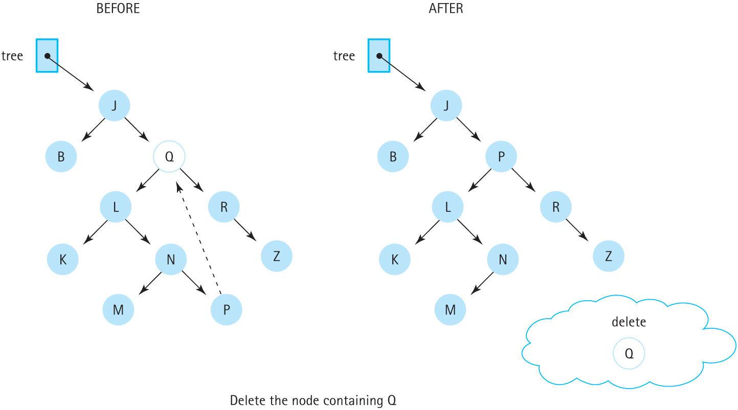
Delete
Figure 8.13 Deleting a node with two children

Slide 39
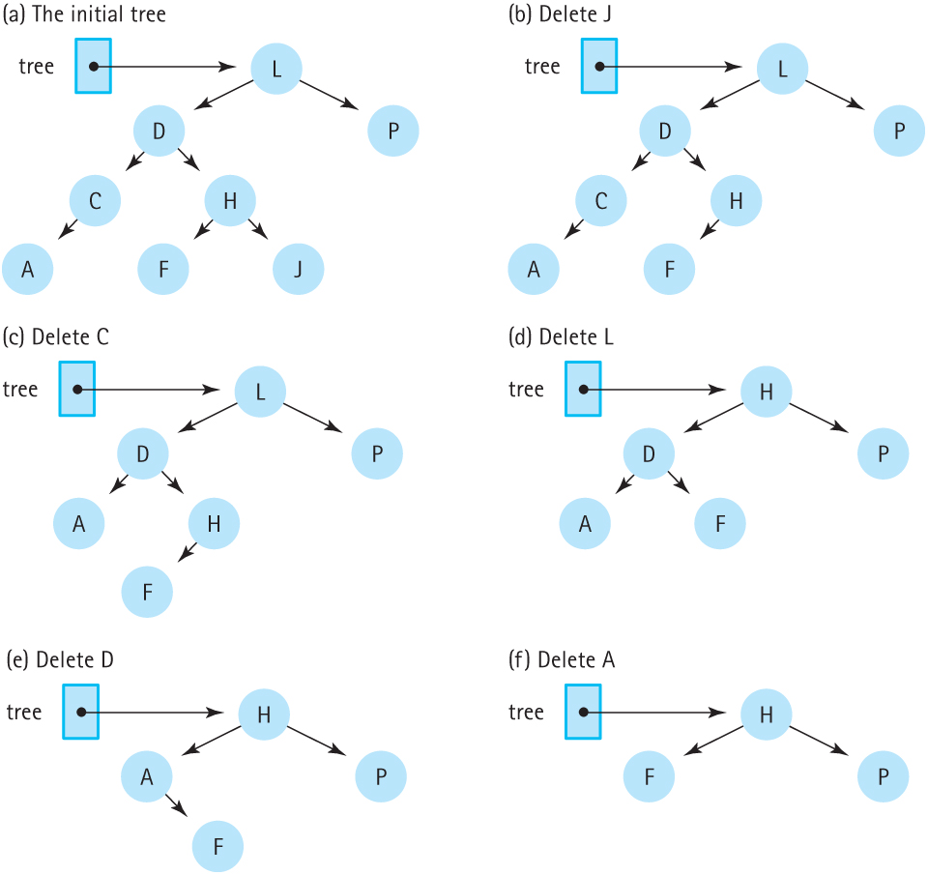
Deleting Multiple Elements
Figure 8.14 Deletions from a binary search tree (a) The intiial tree (b) Delete J
(c) Delete C (d) Delete L (e) Delete D (f) Delete A

Slide 40
Print
Printing a list is easy: Walk the list from beginning to end, printing each value
Binary Search Trees are less straightforward
Do we go left or right first?
Should we print the subtrees or the root node first?
The many ways to traverse a BST are useful in different contexts

Slide 41
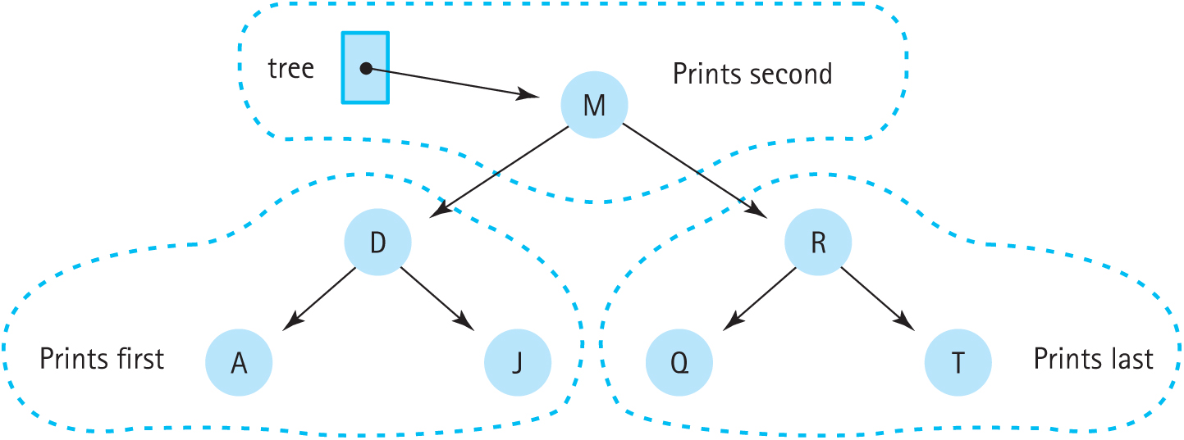
Inorder Traversal
Inorder Traversal accesses the elements of a tree from lowest to highest
That is, first the left subtree is processed, then the root, and finally the right subtree
Figure 8.15 Printing all the nodes in order

Slide 42
Print
Definition: Prints the items of a BST from smallest to largest
Size: The number of items in the tree
Base Case: If tree == NULL, do nothing
General Case: Traverse the left subtree in order, print tree->info, traverse the right subtree in order

Slide 43
PrintTree
void PrintTree(TreeNode* tree, std::ofstream& outFile)
// Prints info member of items in tree in
// sorted order on outFile.
{
if (tree != NULL)
{
PrintTree(tree->left, outFile);
outFile << tree->info;
PrintTree(tree->right, outFile);
}
}

Slide 44
Constructor and Destructor
Constructor: Sets the root to NULL
Destructor: Like Print, this must traverse the tree and access every node
Is inorder traversal the best way? Consider that leaves require less work to delete than nodes with children
Postorder traversal (traverse left subtree, then right subtree, then the node itself) will delete the children first, then the node (which is now a leaf)

Slide 45
Destroy Helper Code
void Destroy(TreeNode*& tree)
// Post: tree is empty and
// nodes have been deallocated.
{
if (tree != NULL)
{
Destroy(tre->left);
Destroy(tree->right);
delete tree;
}
}

Slide 46
Copying a Tree
Both the data and the structure of the original tree are copied into the new tree
The algorithm:
Create a new node and copy the original tree’s information into the node
Copy (newTree->left, originalTree->left)
Copy (newTree→right, originalTree→right)
Stops when originalTree is NULL

Slide 47
CopyTree
void CopyTree(TreeNode*& copy,
const TreeNode* originalTree)
// Post: copy is the root of a tree that is a duplicate
// of originalTree.
{
if (originalTree == NULL)
copy = NULL;
else
{
copy = new TreeNode;
copy->info = originalTree->info;
CopyTree(copy->left, originalTree->left);
CopyTree(copy->right, originalTree->right);
}
}

Slide 48
Copying a Tree
Remember that taking a reference to a pointer (e.g., TreeNode*& copy) allows the function to update the pointer to point to a new object
CopyTree will be called by both the copy constructor and the assignment operator overload function

Slide 49
More About Traversals
Inorder: Visit the left subtree, then the node, then the right subtree. Processes values in order from smallest to largest.
Preorder: The left and right subtrees of a node are processed before the node itself.
Postorder: First the node is processed, then its left subtree, and finally the right subtree.
Print, Delete, and Copy each used these.

Slide 50
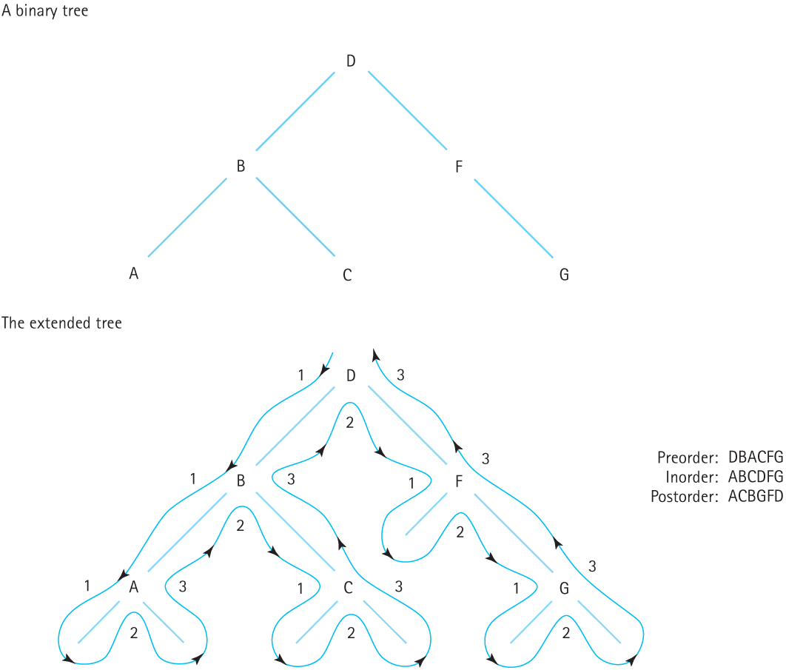
Figure 8.16 Visualizing binary tree traversals

Slide 51
ResetTree and GetNextItem
Logically the same as in other ADTs: ResetTree prepares the tree for iteration and GetNextItem returns the next item.
But which traversal should they support?
All three traversal methods can be supported by these two functions by using a parameter to signal the traversal order.

Slide 52
Iterative Binary Search Trees
It is possible to write the BST operations using iterative techniques
Consider FindNode, which takes a tree and a node to find and returns a pointer to that node and its parent
This can be used by PutItem and DeleteItem to find the insertion point or node to delete

Slide 53
FindNode
void FindNode(TreeNode* tree, ItemType item,
TreeNode*& nodePtr, TreeNode*& parentPtr)
// Post: If a node is found with the same key as item's, then nodePtr points
// to that node and parentPtr points to its parent node.
// If the root node has the same key as item's, parentPtr is NULL.
// If no node has the same key, then nodePtr is NULL and parentPtr points
// to the node in the tree that is the logical parent of item
{
nodePtr = tree;
parentPtr = NULL;
bool found = false;
while (nodePtr != NULL && !found) {
if (item < nodePtr->info) {
parentPtr = nodePtr;
nodePtr = nodePtr->left;
} else if (item > nodePtr->info) {
parentPtr = nodePtr;
nodePtr = nodePtr→right;
} else
found = true;
}
}

Slide 54
Iterative PutItem
The task is the same: Create a new node, find the insertion point, and attach the new node.
FindItem is used to find the insertion point
nodePtr should be NULL and parentPtr will point to the parent to attack the node to
To attach the new node, set the appropriate child pointers on the parent
If the parent is NULL, the new node becomes the root of the tree

Slide 55
Iterative DeleteItem
In the iterative version, DeleteItem uses FindItem to find the node to delete
The rest of the deletion can be handled by DeleteNode, the helper function developed for the recursive version that is not itself recursive

Slide 56
Recursion or Iteration?
We can use the guidelines from Chapter 7 to guide our decision:
Is the recursion shallow? Yes, because well-balanced BSTs have O(log₂N) height.
Is the recursive version shorter or cleaner? Yes.
Is the recursive version less efficient? No. They will always be O(log₂N).

Slide 57
Binary Trees vs. Linked Lists
BSTs combine the best features of the sorted array-based list and the linked list
The main draw is the O(log₂N) searching, insertion, and deletion operations
The extra pointers do take up more memory, and the algorithms are a little more complex
BSTs are better suited to random rather than sequential access of elements

Slide 58
Binary Trees vs. Linked Lists: Big-O
Binary Search Tree efficiency relies on balanced trees; degenerate trees (those which look like linked lists) are not as efficient
BSTs match the performance of array-based sorted list when searching for items
GetLength can be O(N), though maintaining a length field will make it O(1)

Slide 59
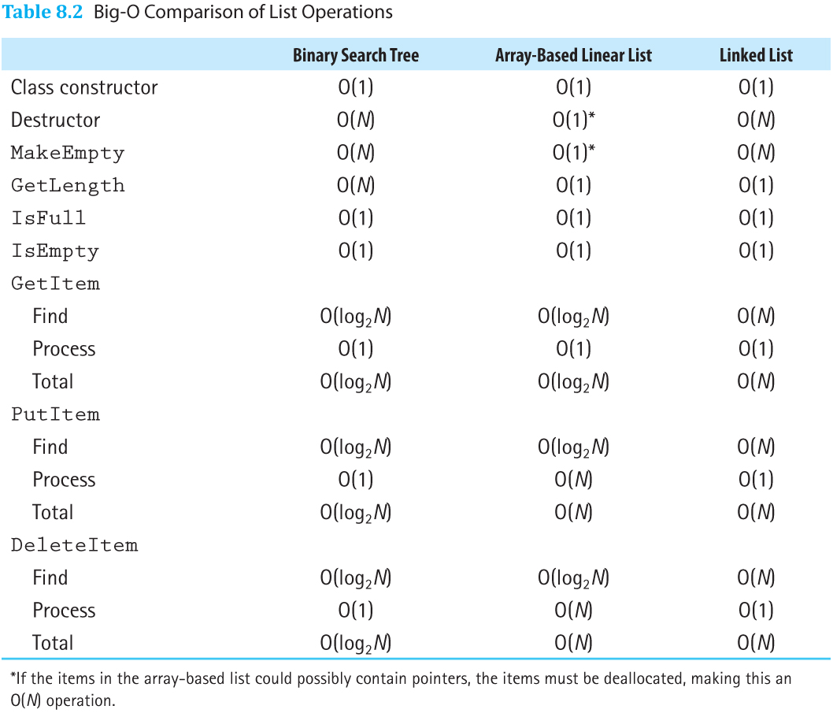
Binary Trees vs. Linked Lists: Big-O
Table 8.2 Big-O Comparison of List Operations

